Slide 1
WebWork + AJAX
A winning combination
Patrick A. Lightbody

Slide 2
Introduction
What is WebWork?
What is OpenSymphony?
The state of web applications
  Yesterday, today, and tomorrow
Who is Patrick?
Is AJAX here to stay?

Slide 3
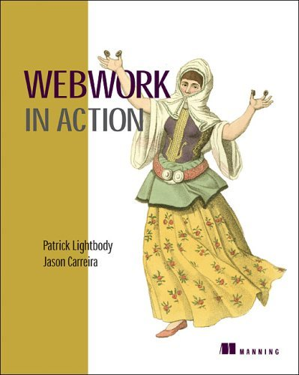
eBook now available
Print version ready “any day now”
A free copy will be given away at the end of the session

Slide 4
AJAX
AJAX = Asyncronous JavaScript and XML
Examples
  Gmail
  Google maps
  Jive group chat
  Microsoft Outlook Web Access
All use XmlHttpRequest
  Platform compatibility?

Slide 5
A simple action
A look at the general flow of WebWork actions
A simple example of the template library’s power
Remember: all the AJAX features of WebWork are built using the template library
AJAX is really just a bunch of JavaScript, HTML, and sloppy logic smashed together in a big train wreck!

Slide 6
Clean code…
<@ww.form action="createPerson"
method="post">
<@ww.textfield label="Name"
name="person.name"/>
<@ww.textfield label="Email"
name="person.email"/>
<@ww.submit value="Create person"/>
</@ww.form>

Slide 7
… is still really a train wreck
<form id="updatePerson"
action="updatePerson.action"
method="post">
<table>
<tr>
<td>Name:</td>
<td><input id="updatePerson_person.name"
name="person.name"/></td>
</tr>
...
</table>
</form>

Slide 8
Uses of AJAX
What exactly does it mean to “ajaxify” your web application?
AJAX is a technique; not a technology.
Caution: AJAX can be overused!
Common AJAX techniques:
  Tabbed pane
  Validation
  Polling
  Tree widget

Slide 9
Building blocks
Three core building blocks/tags:
  @ww.div
  @ww.a
  @ww.submit
divs are where things “happen”
Links and submit buttons can trigger events

Slide 10
Building blocks (cont)
Two frameworks used:
  DWR: Remote invocation service for Java <-> JavaScript
  Dojo: Language/server-agnostic JavaScript framework
Two styles of AJAX:
  DOM manipulation (DWR)
  "Partial pages" (Dojo)
WebWork provides three Dojo widgets:
  BindDiv
  BindAnchor
  BindButton

Slide 11
Div tag
Attributes:
  href
  updateFreq
  delay
  loadingText
  errorText
  showErrorTransportText
  listenTopics
  afterLoading
Usage:
  <@ww.div …/>

Slide 12
Polling
Simple use of the @ww.div tag!
  Just set the href and the frequency
Note: remote action returns HTML
Example:
  <@ww.url id=“url” value=“mailbox.action”
  mailboxId=“${mailboxId}”/>
  <@ww.div href=“%{#url}” updateFreq=“2000”/>

Slide 13
Stock quote example
<#list symbols as symbol>
<@ww.url id="url"
value="quote.action"
symbol="${symbol}"/>
<@ww.div href="%{#url}"
updateFreq="900000"/>
</#list>

Slide 14
Stock quote example (cont.)
public class Quote {
String symbol;
Stock stock;
public String execute() {
stock = StockMgr.lookup(symbol);
return SUCCESS;
}
}

Slide 15
Stock quote example (cont.)
<div class="quote">
${stock.symbol}: ${stock.price}
</div>

Slide 16
Stock quote example (cont.)
<div dojoType="BindDiv"
href="quote.action?symbol=GOOG"
refresh="900000"/>

Slide 17
Compatibility
That's great, but what about older browsers?
With the stock quote example, they would see nothing!
WebWork and Dojo address this as much as possible
Warning: Intelligent fallback can be difficult and sometimes impossible!

Slide 18
Compatibility
<@ww.div href="%{#url}"
updateFreq="900000">
<@ww.action name="quote"
symbol="${symbol}"
executeResult="true"/>
</@ww.div>

Slide 19
Compatibility (cont.)
<div dojoType="BindDiv"
href="quote.action?symbol=GOOG"
refresh="900000">
<div class="quote">
GOOG: $82,000.00
</div>
</div>

Slide 20
Tabbed pane
Two tags:
  @ww.tabbedPanel
  @ww.panel
The panel tag extends the div tag
  tabName
  remote
Usage:
  <@ww.tabbedPanel …>
  <@ww.panel …/>
  <@ww.panel …/>
  </@ww.tabbedPanel>

Slide 21
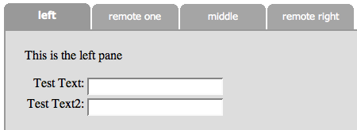
Tabbed Pane

Slide 22
Example
<@ww.tabbedPanel>
<@ww.panel tabName="Details">
<h1>Stock details</h1>
...
</@ww.panel>
<@ww.panel remote="true"
tabName="Price"
href="%{#url}"/>
<@ww.tabbedPanel>

Slide 23
Topic-based events
Dojo supports an event system, donated by the WebWork developers
Any element, such as a div, may listen on multiple topics
Any element, such as an href or tab header, may notify a topic
What happens when the topic is notified is up to the receiving element
Important: topics get you away from document.getElementXxx()

Slide 24
Tree widget: events in action
A tree widget is actually one of the simplest AJAX techniques to build
Assume a model that provides a getChildren() call, such as Category.getChildren()
Utilizes two building blocks: divs and links.

Slide 25
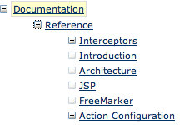
Tree widget

Slide 26
Tree widget example
Requirements:
  An action that gets a list of children when given a category ID
  A template to render the tree
  A template to kick off the initial tree display
  An action that returns JavaScript as the result
Initial display can be done with the action tag:
  <@ww.action name="listCategories.action"
  executeResult="true"/>

Slide 27
Tree widget example
<#list categories as cat>
<#if cat.children.size > 0>
<#assign icon="plus"/>
<#else>
<#assign icon="square"/>
</#if>
<@ww.a notifyTopics="children_${cat.id}"
href="toggle.action?id=${cat.id}">
<img src="${icon}.gif"/>
</@ww.a>
[EXAMPLE CONTINUED]
</#list>

Slide 28
Tree widget example
<@ww.url id="url"
value="listCategories.action"
id="${cat.id}"/>
<@ww.div id="children_${cat.id}"
cssStyle="display: none"
href="%{#url}"
listenTopic =
"children_${cat.id}"/>

Slide 29
Tree widget example
if (${childCount} > 0 {
var div = $("children_${id}");
var style = div.style;
if (style.display == "none") {
style.display = "";
} else {
style.display = "none";
}
}

Slide 30
Validation
Uses DWR; requires the DWR servlet installed
Note: remote calls return serialized objects (not HTML "partials")
Is a very different style of AJAX
Uses onBlur events
Example:
  <@ww.form action="createPerson"
  validate="true">
  ...
  </@ww.form>

Slide 31
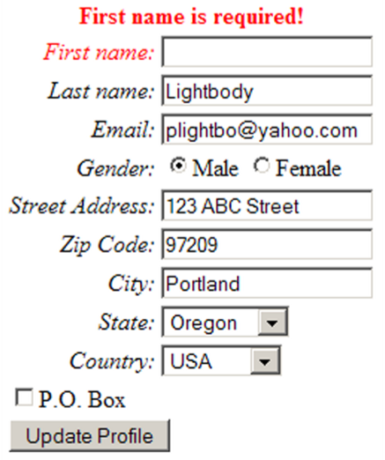
Validation

Slide 32
Pitfalls
Remember: there is no silver bullet
At the end of the day, your application is still a web site - don’t forget that
Excessive polling can lead to extreme load and/or thread starvation
Common functionality, such as the back button and printing, can become difficult or confusing for the user
Browser incompatibility can lead to two versions of the same application (see gmail)

Slide 33
Wrap up
Built in WebWork features:
  Tabbed pane
  Validation
  Polling
  More coming soon!
A mix of AJAX technologies - the space is very fragmented (much like Java web frameworks!)

Slide 34
Questions?

